Slide 1



Corona Virus Analysis with SQL
Internship Project By Kokumo Moses O. with Mentorness
BATCH-MIP-DA-07
kokumomoses@gmail.com
+2347031089194

Slide 2



CONTENTS.
Introduction.
Dataset Overview.
Data Exploration & Analysis Using SQL
Key Findings.
Conclusion.

Slide 3
INTRODUCTION.
The CORONA VIRUS pandemic has had a significant impact on public health and has created an urgent need for data-driven insight to understand the spread of the virus. As a data analyst, I analyzed the corona virus dataset to derive meaningful insights and present findings.

Slide 4
DATASET OVERVIEW.
PROVINCE: Geographic subdivision within a country/region.
COUNTRY/REGION: Geographic entity where data is recorded.
LATITUDE: North south position on earth surface.
LONGITUDE: East-west position on earth surface.
DATE: Recorded date of corona virus data.
CONFIRMED: Number of diagnosed corona virus cases.
DEATHS: Number of corona virus related deaths.
RECOVERED: Number of recovered corona virus cases.

Slide 5
DATA EXPLORATION AND ANALYSIS.
Setting up our database.
Analyze data to answer questions.

Slide 6
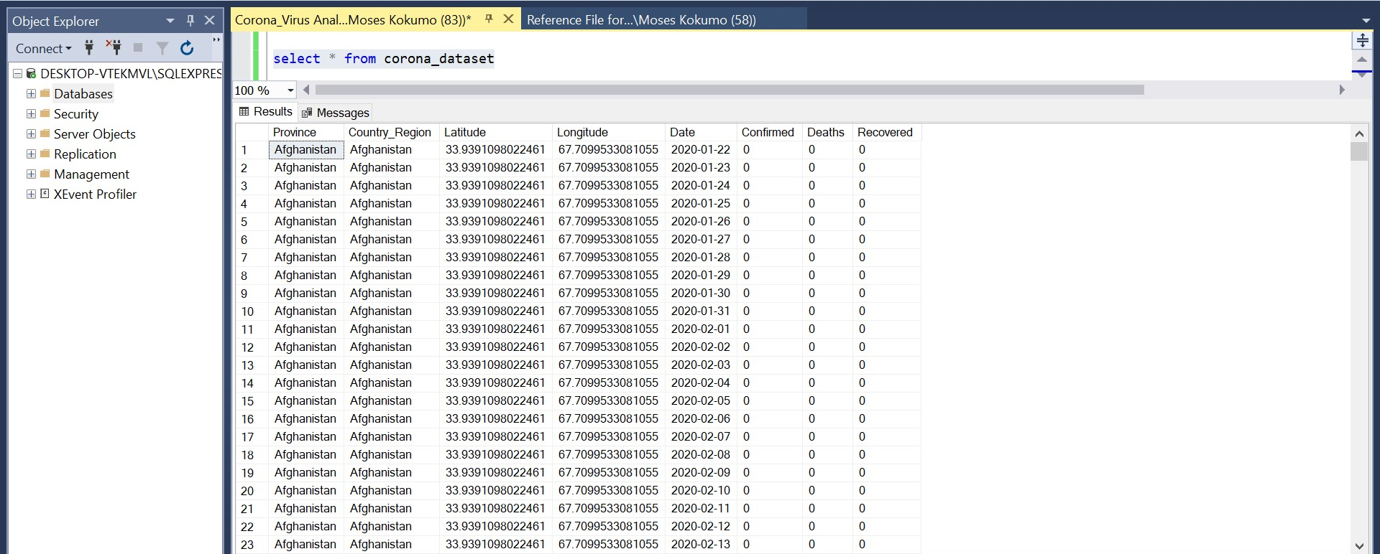
SETTING UP OUR DATABASE.

Slide 7
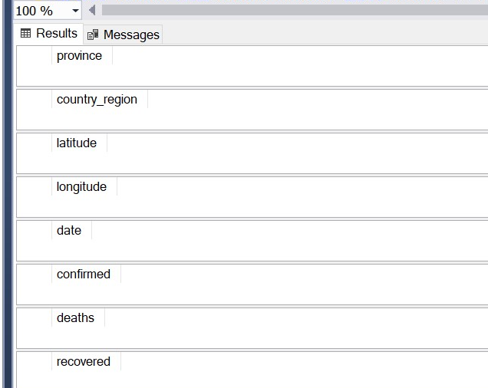
Problem 1: Write a code to check NULL values
Output:
select province from corona_dataset where province is null
select country_region from corona_dataset where country_region is null
select latitude from corona_dataset where latitude is null
select longitude from corona_dataset where longitude is null
select date from corona_dataset where date is null
select confirmed from corona_dataset where confirmed is null
select deaths from corona_dataset where deaths is null
select recovered from corona_dataset where recovered is null

Slide 8
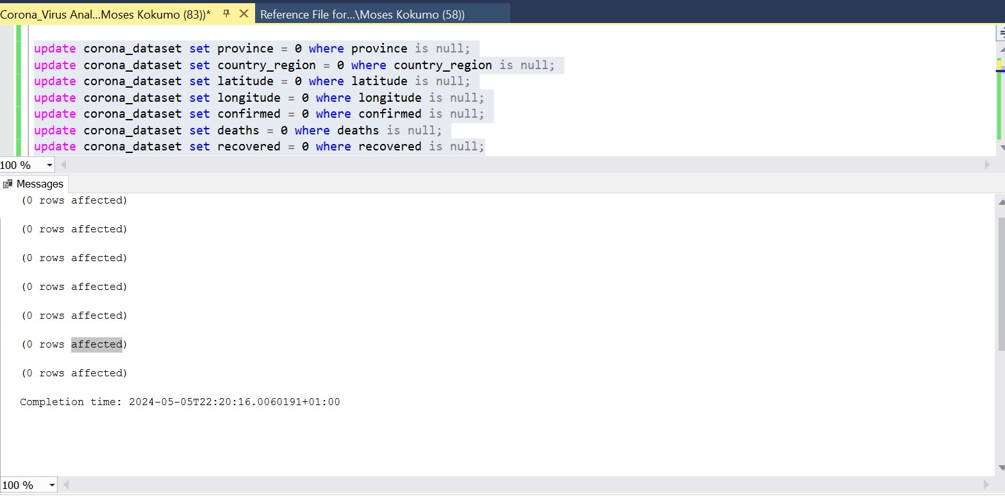
PROBLEM 2: IF ANY NULL VALUES ARE PRESENT, UPDATE THEM WITH ZERO FOR ALL COLUMNS
Output:
update corona_dataset set province = 0 where province is null;
update corona_dataset set country_region = 0 where country_region is null;
update corona_dataset set latitude = 0 where latitude is null;
update corona_dataset set longitude = 0 where longitude is null;
update corona_dataset set confirmed = 0 where confirmed is null;
update corona_dataset set deaths = 0 where deaths is null;
update corona_dataset set recovered = 0 where recovered is null;

Slide 9
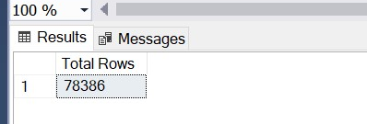
Problem 3: Check total numbers of rows.
Output:
select count (*) as [Total Rows] from corona_dataset;

Slide 10
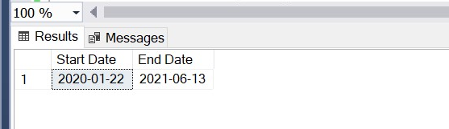
Problem 4: Check what is start_date and end_date.
Output:
select min(date) as [Start Date], max(date) as [End Date]
FROM corona_dataset;

Slide 11
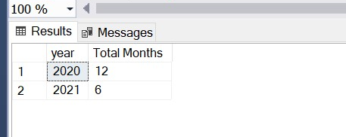
Problem 5: Number of months present in dataset.
Output:
select
year(date) as year,
count(distinct month(date)) as [Total Months]
from corona_dataset
group by year(date);

Slide 12
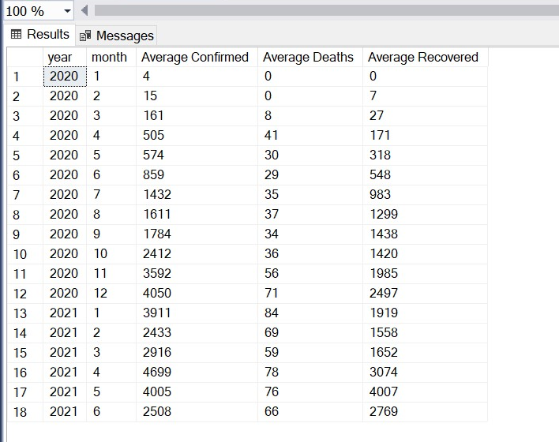
Problem 6: Find monthly average for confirmed, deaths & Recovered.
Output:
select
year(date) as year,
month(date) as month,
avg(confirmed) as [Average Confirmed],
avg(deaths) as [Average Deaths],
avg(recovered) as [Average Recovered] from corona_dataset
group by year(date), month(date)
order by year(date), month(date);

Slide 13
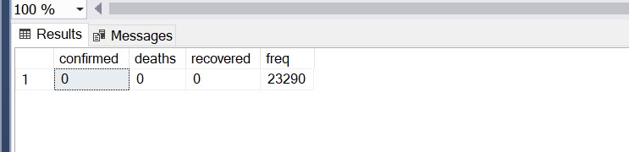
Problem 7: Find most frequent value for confirmed, deaths, recovered each month
Output:
with freq_cte as (
select confirmed,deaths,recovered,count(*) as freq from corona_dataset group by confirmed,deaths,recovered)
select * from freq_cte
where freq= (select max(freq) from freq_cte)

Slide 14
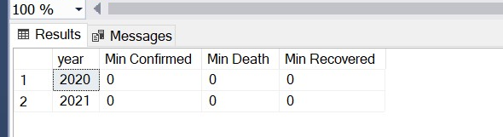
Problem 8: Find minimum value for confirmed, death and recovered per year.
Output:
select
year(date) as year,
min(confirmed) as [Min Confirmed],
min(deaths) as [Min Death],
min(recovered) as [Min Recovered]
from corona_dataset
group by year(date)
order by year(date);

Slide 15
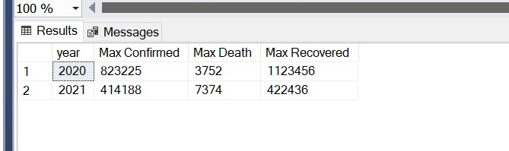
Problem 9: Find maximum value for confirmed, death and recovered per year.
Output:
select
year(date) as year,
max(confirmed) as [Max Confirmed],
max(deaths) as [Max Death],
max(recovered) as [Max Recovered]
from corona_dataset
group by year(date)
order by year(date);

Slide 16
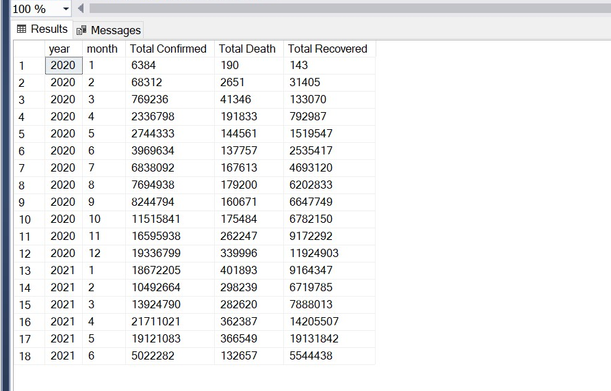
Problem 10: Total Number of case of confirm, deaths and recovered each month.
Output:
select
year(date) as year,
month(date) as month,
sum(confirmed) as [Total Confirmed],
sum(deaths) as [Total Death],
sum(recovered) as [Total Recovered]
from corona_dataset
group by year(date), month(date)
order by year(date), month(date);

Slide 17
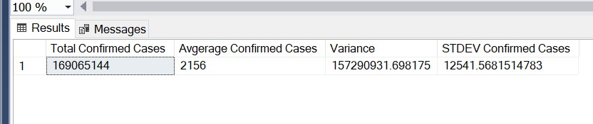
Problem 11: Check how corona virus spread out with respect to confirmed case (E.g.: total confirmed cases, their average, variance & STDEV )
Output:
select
sum(confirmed) as [Total Confirmed Cases],
avg(confirmed) as [Average Confirmed Cases],
var(confirmed) as Variance,
stdev(confirmed) [STDEV Confirmed Cases]
from corona_dataset;

Slide 18
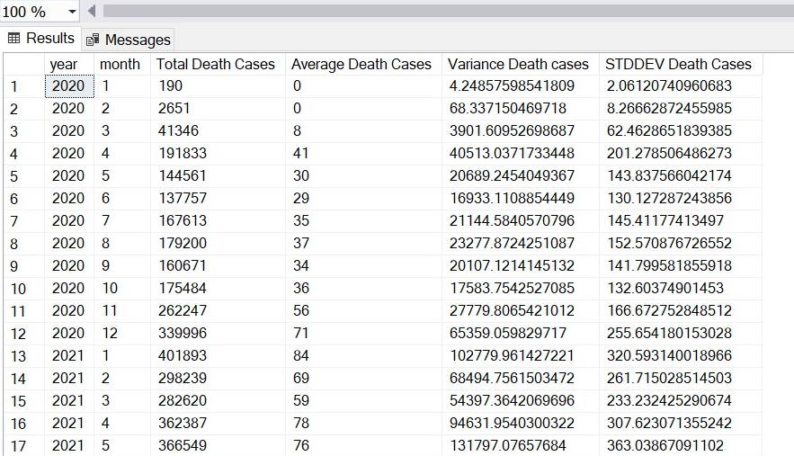
Problem 12: Check how corona virus spread out with respect to death case per month (E.g.: total confirmed cases, their average, variance & STDEV)
Output:
select
year(date) as year,
month(date) as month,
sum(deaths) as [Total Death Cases],
avg(deaths) as [Average Death Cases],
var(deaths) as [Variance Death cases],
stdev(deaths) [STDDEV Death Cases]
from corona_dataset
group by year(date), month(date)
order by year(date), month(date);

Slide 19
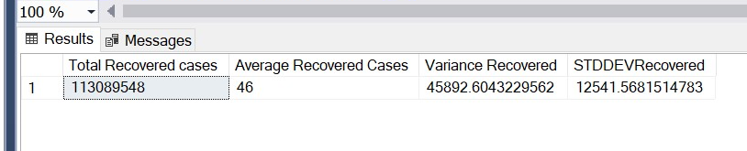
Problem 13: Check how corona virus spread out with respect to recovered case (Eg.: total confirmed cases, their average, variance & STDEV )
Output:
select
sum(recovered) as [Total Recovered cases],
avg(deaths) as [Average Recovered Cases],
var(deaths) as [Variance Recovered],
stdev(confirmed) [STDDEVRecovered]
from corona_dataset;

Slide 20
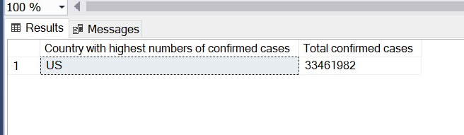
Problem 14: Find Country having highest number of the Confirmed case
Output:
select top 1 country_region as [Country with highest numbers of confirmed cases], sum(confirmed) as [Total confirmed cases] from corona_dataset
group by country_region
order by [Total confirmed cases] desc

Slide 21
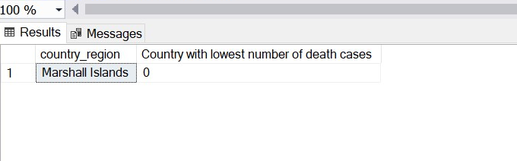
Problem 15: Find Country having lowest number of the death case
Output:
select top 1 country_region, sum(deaths) as [Country with lowest number of death cases] from corona_dataset
group by country_region
order by [Country with lowest number of death cases] asc

Slide 22
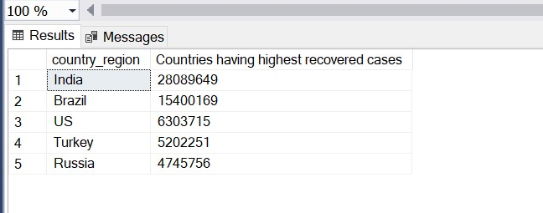
Problem 16: Find top 5 countries having highest recovered case
Output:
select top 5 country_region, sum(recovered) as [Countries having highest recovered cases] from corona_dataset
group by country_region
order by [Countries having highest recovered cases] desc

Slide 23
Key Findings
The analysis revealed a rapid escalation of Covid-19 cases throughout 2020, with a peak in early 2021. Post vaccination , death rate began to stabilize, and there was noticeable improvements in recovery rates, attributable to enhanced treatment protocol and healthcare response.

Slide 24

Conclusion.
Moving forward, research should be focus on evaluating the long-term efficacy of vaccines and the impacts on virus mutations, ensuring that strategies adapt to evolving pandemic dynamics.

